Slide 1
SIMSCAPE Modeling of a 3-RPR PARALLEL PLATE MANIPULATOR
Atharva Sharma
2022MEB1302

Slide 2
INTRODUCTION
The model showcases a 3-RPR parallel plate manipulator, a mechanism which is widely used in robotics. This system, with its three revolute (R), three prismatic (P) and then again three revolute (R) joints, offers dynamic control and can be maneuvered precisely.
APPLICATIONS
1. Precision Positioning:
- Ideal for tasks demanding accurate and controlled movements.
2. Assembly Operations:
- Efficient in assembling components with spatial coordination.
3. Obstacle Avoidance:
- Capable of navigating around obstacles with its flexible design.
4. Educational Tool:
- Valuable for teaching kinematics and dynamics in robotics.

Slide 3
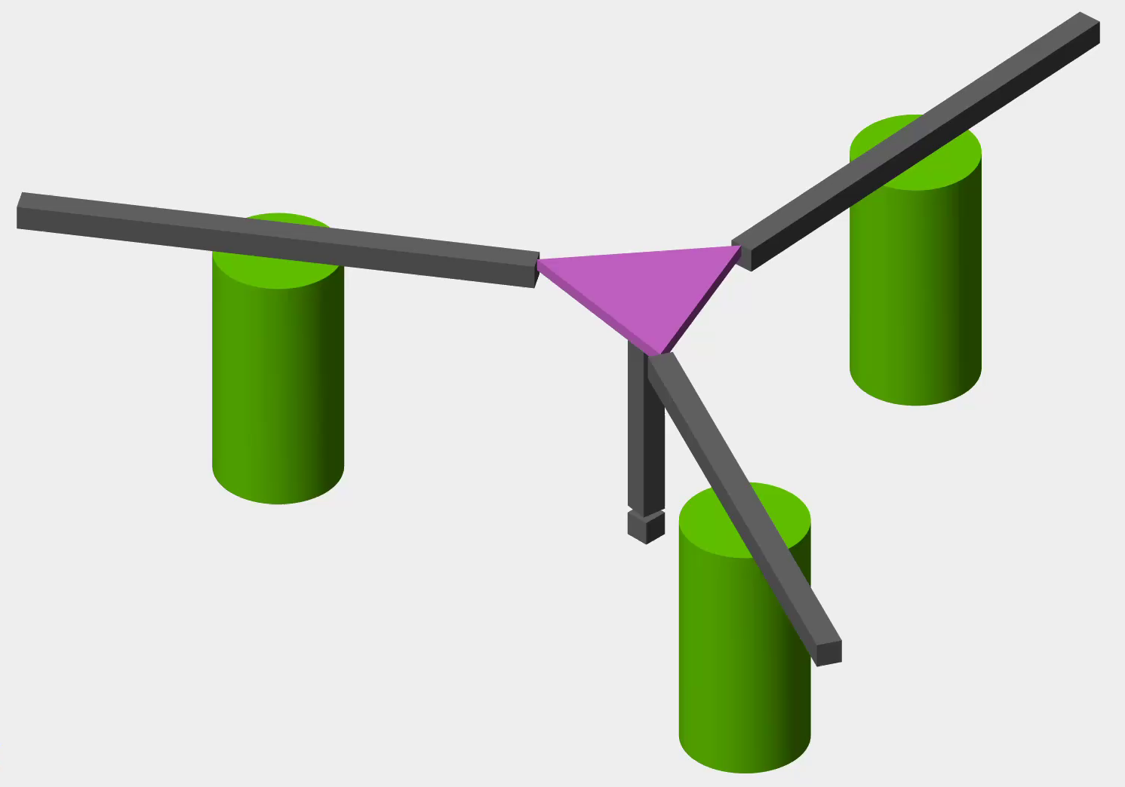
MODEL OVERVIEW
PARTS:
Cylindrical Bases:
Rest on the first revolute joint (R1).
Provides support to the model.
Links:
Connected to the base via the prismatic joint (P1).
Represents the first arm of the manipulator.
Triangular Plate:
Connected to the three links by the second revolute joints (R2).
Defines the plane in which end effector moves.
End Effector:
Represents the tool or platform that interacts with the environment.
Attached to the centre of the triangular plate.
2
3
4
1
Fig. Isometric view of the model

Slide 4
MODEL OVERVIEW
JOINTS:
First Revolute Joint (R1) :
Placed beneath the cylindrical bases.
Allow rotational motion around z-axis.
Prismatic Joint (P1) :
Connects the base with the links.
Allows translation motion along some direction.
Second Revolute Joint (R2):
Connects the parallel plate with the links.
2
3
1
Fig. Isometric view of the model

Slide 5
MODEL OPERATION
The model operates by giving inputs to all three R1 joints and all three P1 joints.
Actuation torque is applied to all R1 joints, and actuation velocity is given to the P1 joints.
Thus, we have a total of 6 inputs, and the system has a unique solution.
The movement of the R2 joints is automatically calculated, and they drive the motion of the parallel plate.
The end effector, attached to the centre of the plate, moves along its locus.
P1
R2
R1
Fig. Isometric view of the model

Slide 6
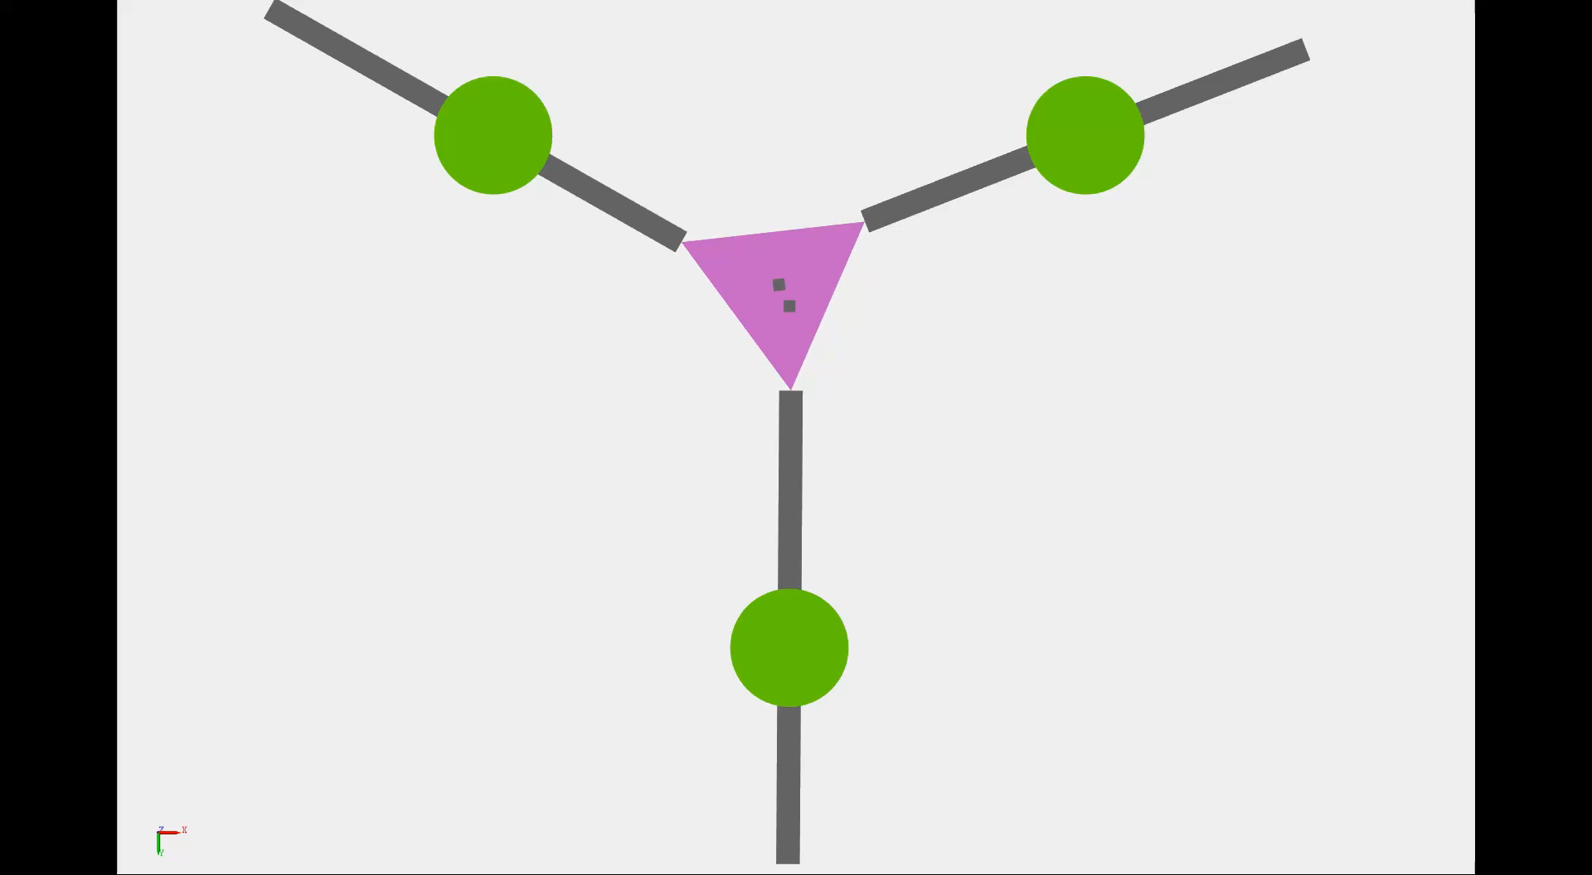
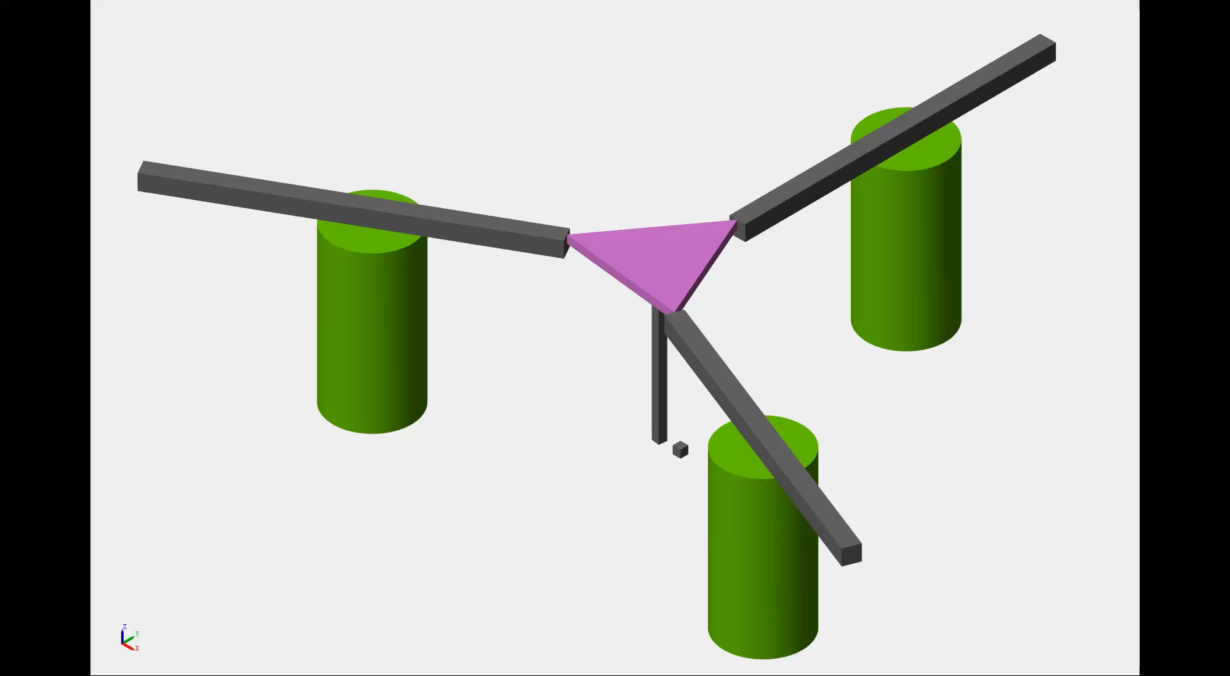
INPUT: SINE WAVE
If we provide sine wave inputs to all R1 joints with the same amplitude and a phase difference of 120°, and similarly apply sine waves to the P1 joints, we will obtain the locus of the end effector as a circle.
Animation: Bottom View
Animation: Isometric View

Slide 7
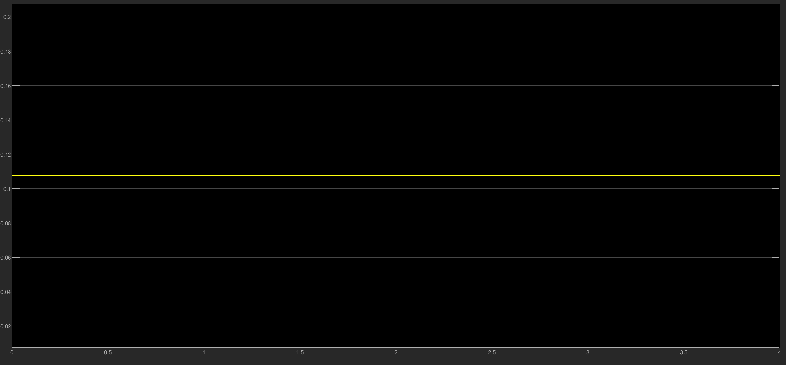
SINE WAVE INPUT: GRAPHS
This is the plot of the z position of the centre of the triangular plate (wrt the world frame) v/s time.
This plot shows that the plate remains parallel wrt the base frame at any time.
Plot: z (m) v/s time (s)

Slide 8
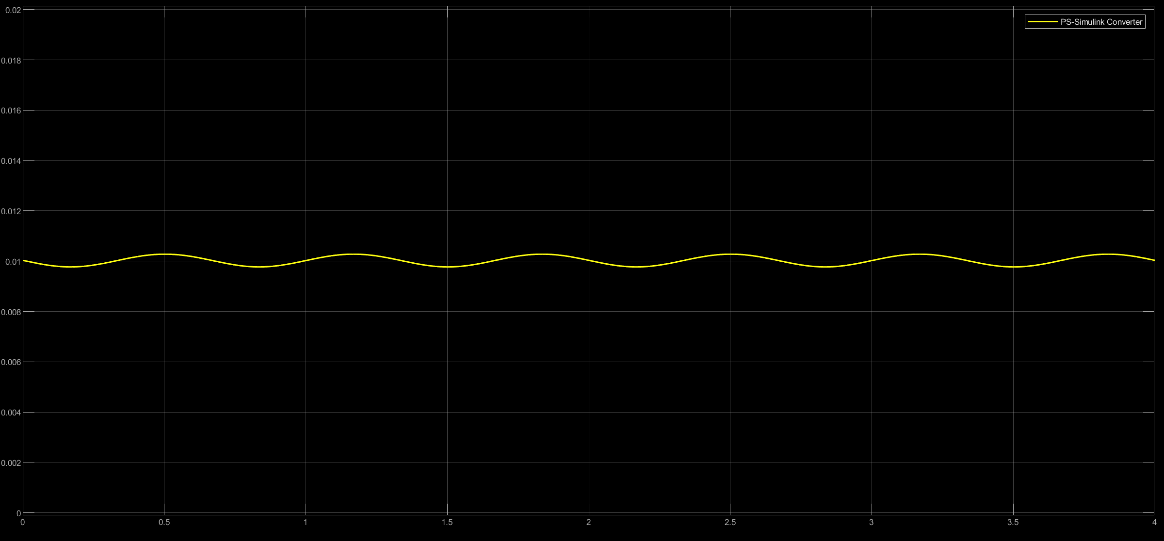
SINE WAVE INPUT: GRAPHS
This is the plot of the distance between the fixed point beneath the initial position (i.e. the hypotenuse) and the centre of the plate v/s time.
This plot indicates some variation of radius with time (~5% variation). The reason for this might be that accurate values of pi and roots of numbers were not added in some places (I could not find any way to do so).
Plot: Distance between base and plate centre (m) v/s time (s)

Slide 9
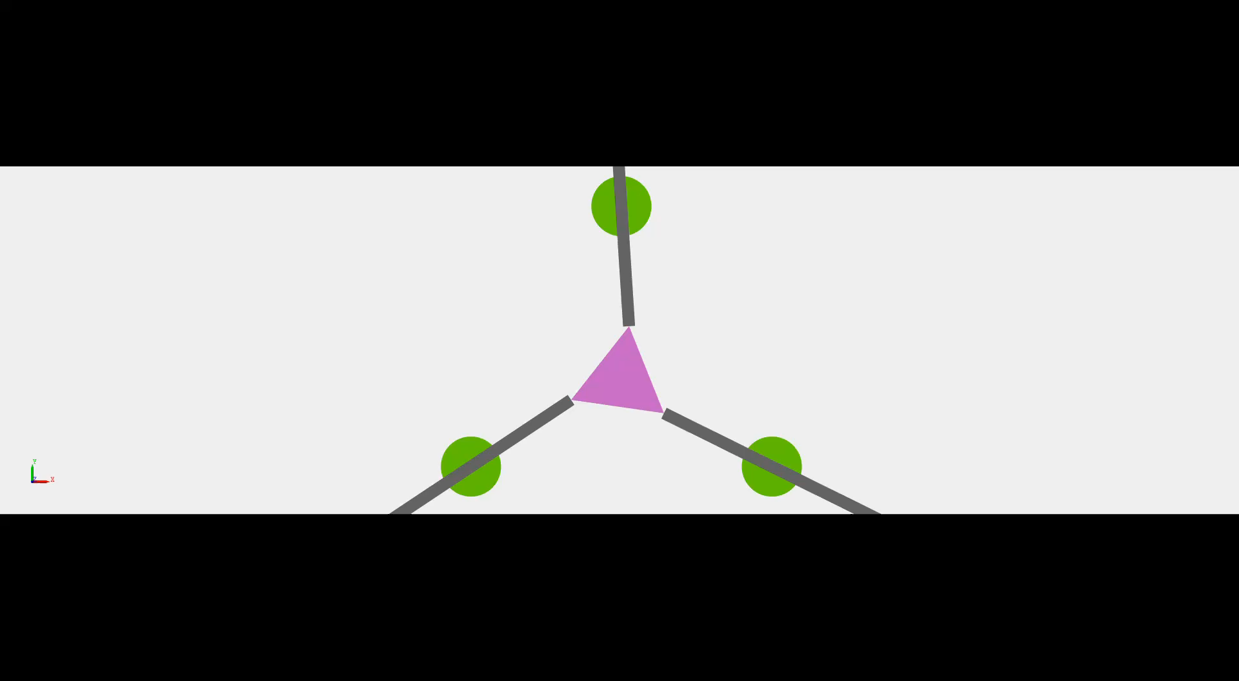

INPUT: CONSTANT VALUE
If we provide constant inputs of the same value to all R1 joints, and similarly apply constant value inputs (again of the same value) to the P1 joints, the end effector will have zero displacement and will only rotate about the z-axis.
Animation: Top View
Animation: Isometric View

Slide 10
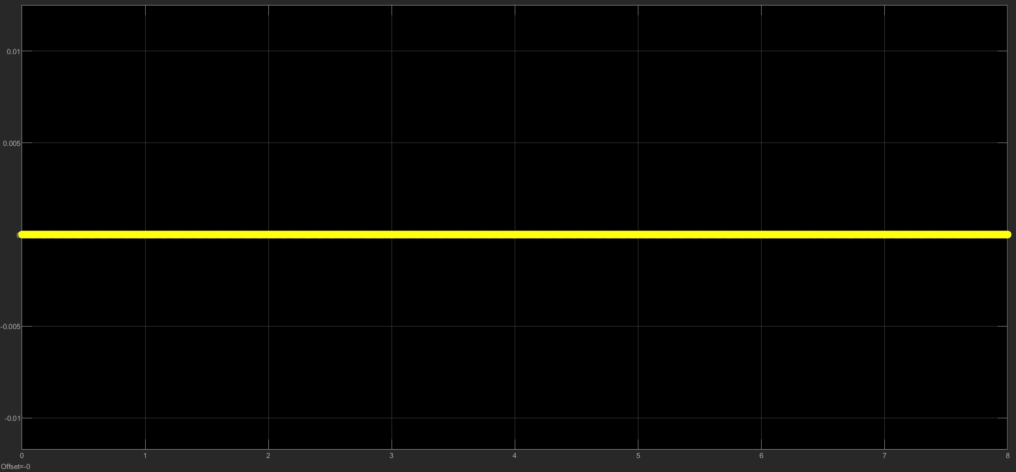
CONSTANT INPUT: GRAPHS
This is the plot of the z position of the centre of the triangular plate (wrt the world frame) v/s time.
This plot shows that the end effector has no translation in any axis.
Plot: Distance between base and plate centre (m) v/s time (s)

Slide 11
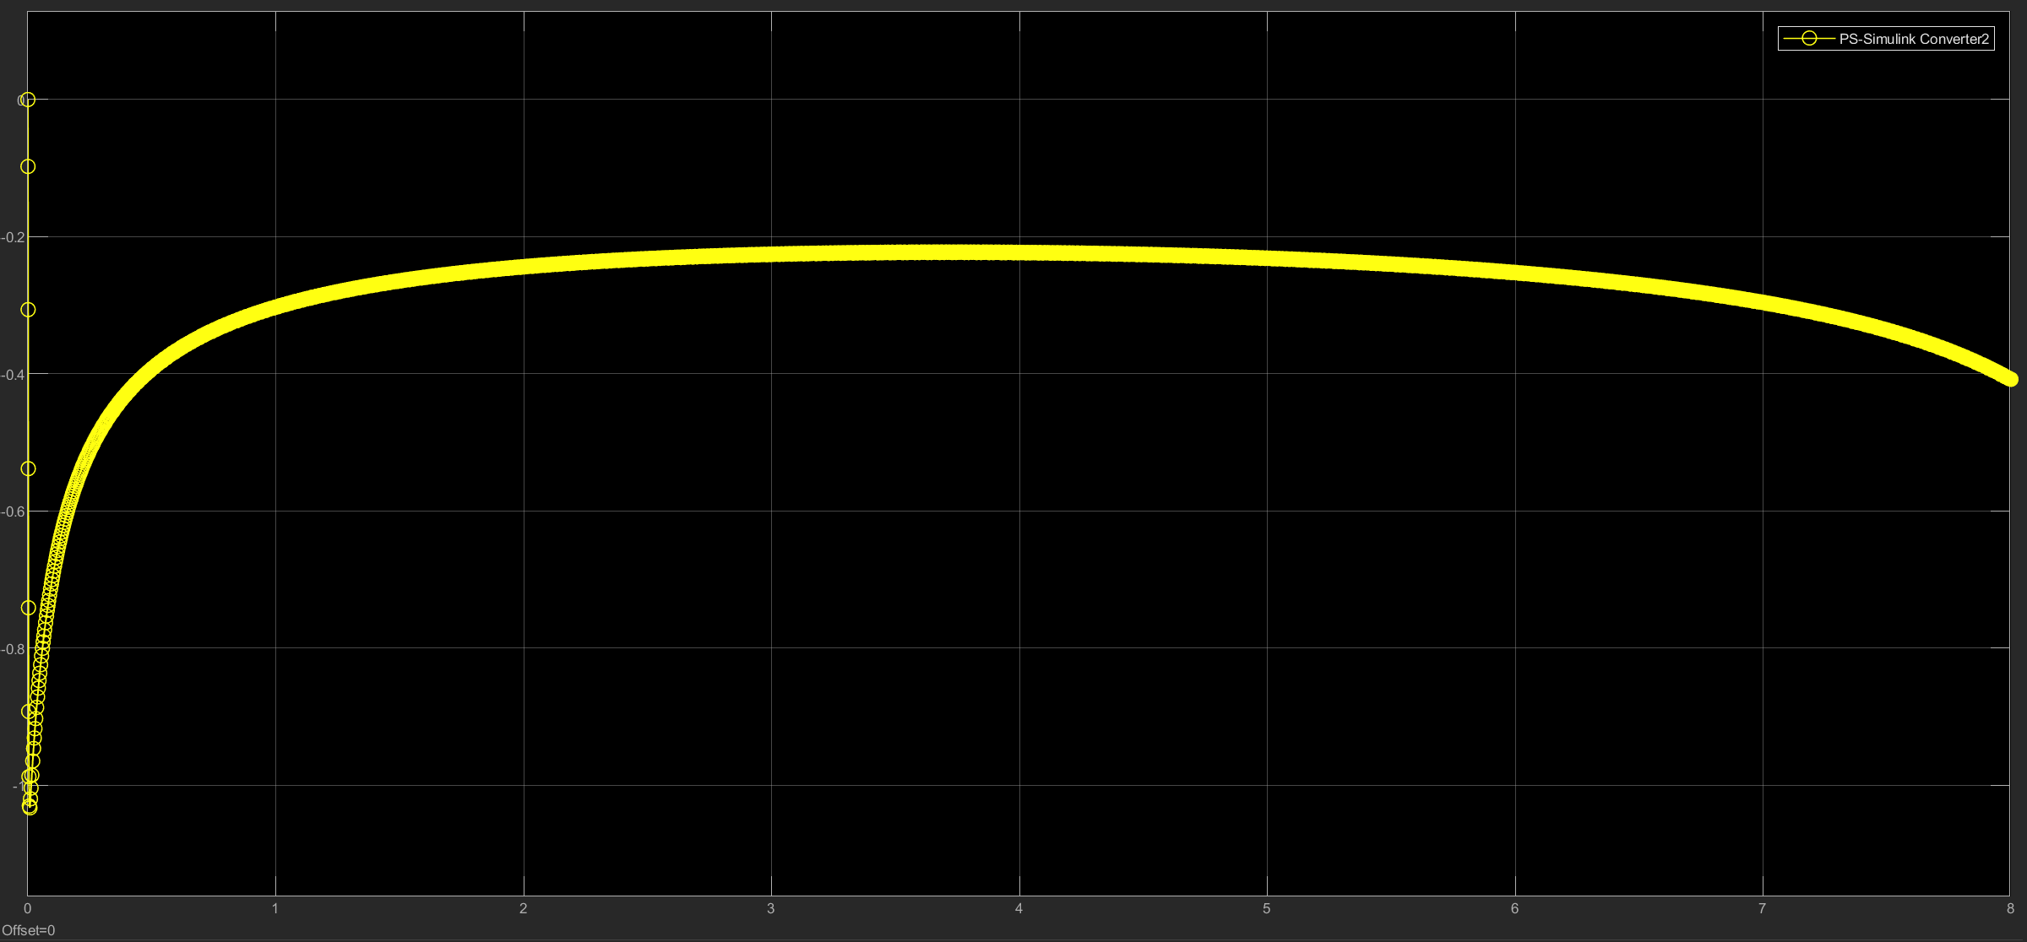
CONSTANT INPUT: GRAPHS
This is the plot of the angular velocity of the end effector about the z-axis.
This plot shows that the angular velocity first increases, then becomes constant and then decreases a bit.
This can be observed in the animation.
Plot: Angular Velocity about z-axis (rad/s) v/s time (s)

Slide 12
REFERENCES
The model is designed taking inspiration from this video: https://youtu.be/I4oASWYzF8o?si=O5ZXgzRxmdBFY4ir
I got a lot of help from ChatGPT in using and understanding Simscape and understanding concepts related to the manipulator.
Simulink documentation
The slider crank model sent on classroom was a big help in understanding Simscape.
The working and theory behind the manipulator from these papers:
Merlet, Jean-Pierre. (1996). Direct kinematics of planar parallel manipulators. Proceedings - IEEE International Conference on Robotics and Automation. 4. 10.1109/ROBOT.1996.509284.
ethesis.nitrkl.ac.in/5876/1/212ME1274-5.pdf (Sorry, I couldn’t find a citation) (And the link was not working for me, so I’ll attach the pdf along with this ppt)
Assal, Samy. (2012). Self-organizing approach for learning the forward kinematic multiple solutions of parallel manipulators. Robotica. 30. 1 - 11. 10.1017/S0263574711001172. (for the theory)
My friends, Atharv Srivastava and Vaishnavi Gawrishankar helped me with some theory and Simscape.

